Slide 1

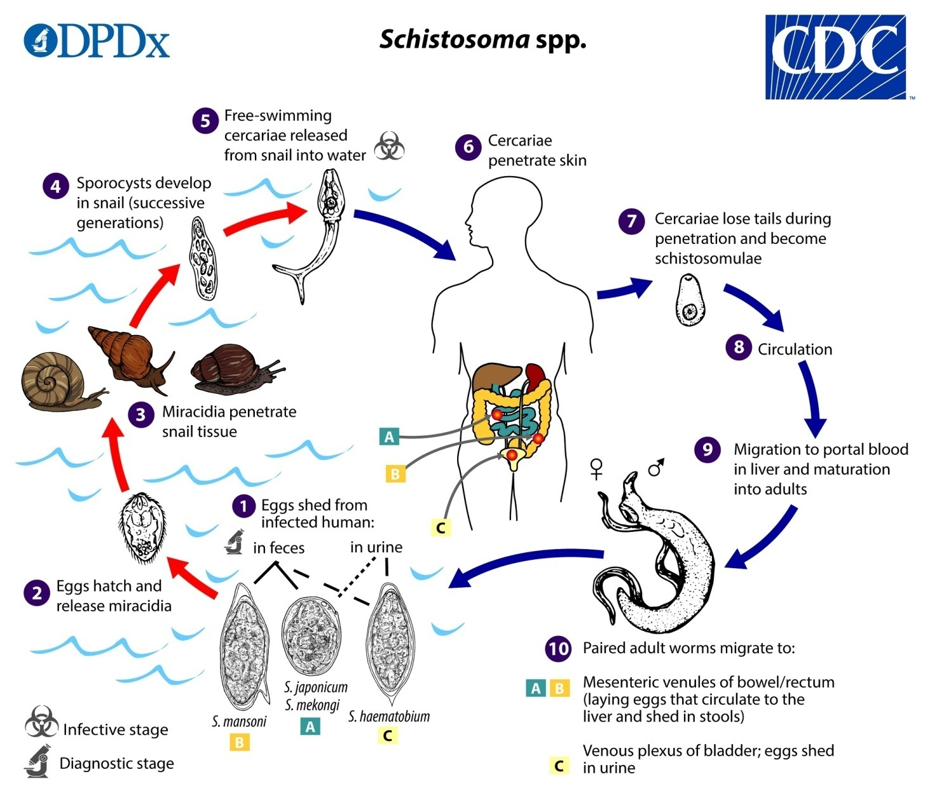
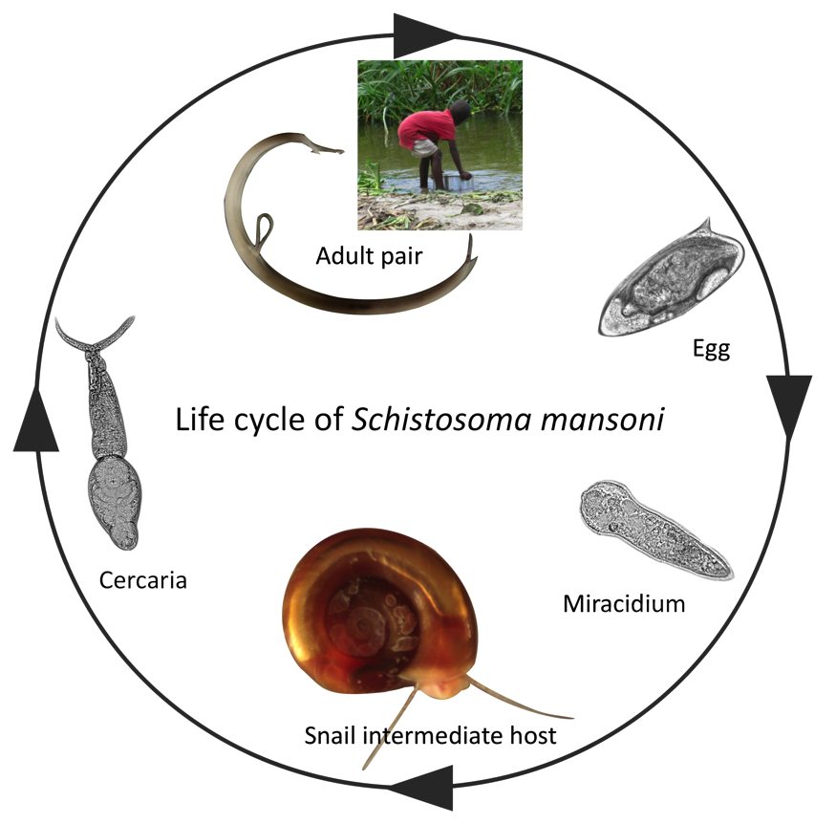
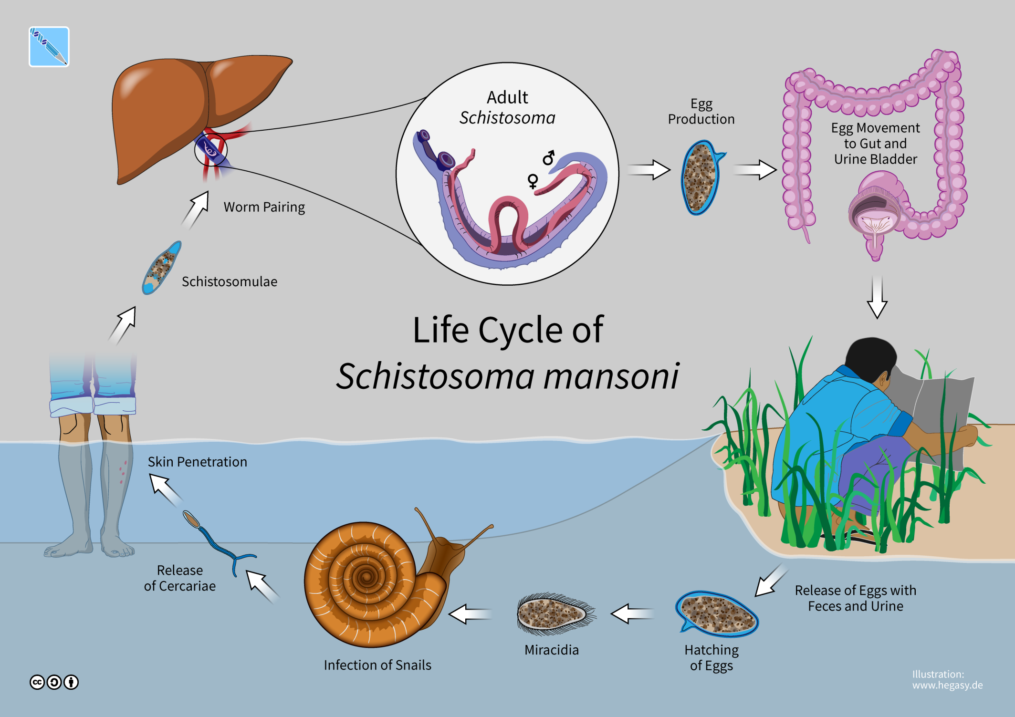
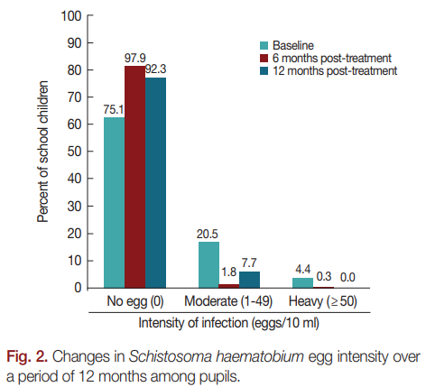
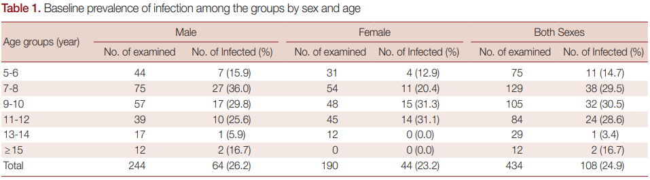
Impact of Single Dose Praziquantel Treatment on Schistosoma haematobium Infection among School Children in an Endemic Nigerian Community
Babatunde Adewale1*, Margaret A. Mafe1,Medinat A. Sulyman1, Emmanuel T. Idowu2, Morakinyo B. Ajayi1David O. Akande1, James H. Mckerrow3, Emmanuel O. Balogun4
Introduction
Abstract
Materials/methods
Data analysis
Schistosomiasis which is also known as Bilharzia is a disease that s caused by parasitic worms which lives in certain types of snails found in freshwater. When consuming the water which is contaminated, infection can occur. This disease is a serious threat when it comes to public health is s a co factor in the transmission of HIV. The parasites penetrate through skin. Over 250 million people worldwide have been affected with 11,700 annual deaths. Females who are infected are HIV spreading risks.
In Nigeria, Schistosomiasis is prevalent and foremost Schistosoma haematobium pathogen which affects about 29 million people. For treatment, a single dose of the drug praziquantel is recommended but the efficiency has not been documented in certain regions. Therefore, this study outputs by microscopy. The prevalence was 24.9% at pre-treatment. was designed to assess the impact of single dose praziquantel treatment on S. haematobium infection among school children in an endemic community of South-Western Nigeria. Urine samples were collected from 434 school children and 10ml was filtered through Nucleopore filter paper for egg examination
The location of this study is Ipogun, Ondo Nigeria. Sample size is 434 children, 244 males and 190 females. This is longitudinal study which took 12 months. Schoolchildren were the participants aged 5-18 where urine samples were collected, examined, and recorded. The children were enrolled in a study school , a private school and 3 schools that were public. The samples of urine were labeled. The Each samples were examined within 10-14 hour the eggs of Schistosoma and recorded. 4-Praziquantel dose of 40 mg per kg of body weight was used.
.
IBM SPSS version 20 was used to analyze the demographic data.
Descriptive statistics in frequencies, charts, percentages presented the results.
Chi square was used to perform inferential statistics.
Limitations
Implications
Future directions
Conclusion
The sample size showed low rate of infection (25%)
Season influence and weather influences the infection rate.
.
The community main habits contributes to the infection rate increasing.
The communities should be educated about importance of clean water.
Praziquantel should continue to be used.
A slight infection rate increase significantly implies the need to treat every year constantly for elimination achievement by end of 2020.
Disease transmission and treatment needs constant monitoring efforts.
Control measures such as health education and snail control are needed.
Younger age group (9-10) are more likely to be infected with Schistosomiasis and the lowest rate of infection was shown at private schools because of their economical status.. Within 6 treatment methods, the results showed that Praziquantel seems to be effective significantly. There was slight increase in the rate of infection after 12 months.
Results
The study's’ results showed that before the treatment, the prevalence of the egg in the sample was about 25% and with no difference that was significant in the rate of infection between males and females. (Males-14.7% and females 10.2%). Age group of 9-10 showed more infection prevalence and followed by age-group 7-8, and the lowest prevalence of age group was 13-14 years old. The infection prevalence dropped to 2.1% after six treatment months implying 91.6% reduction rate. The infection rate increased to 7.7% after 12 months implying 69.1% reduction rate compared to baseline.

